Slide 1
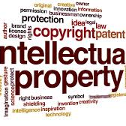
Intellectual Property Act

Slide 2

What is it?
Having the right type of intellectual property protection helps you to stop people stealing or copying things such as:
The names of your products or brands
Your inventions
The design or look of your products
Things you write, make or produce

Slide 3

What does it cover?
Intellectual Property covers:
Stories
Inventions
Artistic works
Symbols
Names
Creations
Logos

